Slide 1

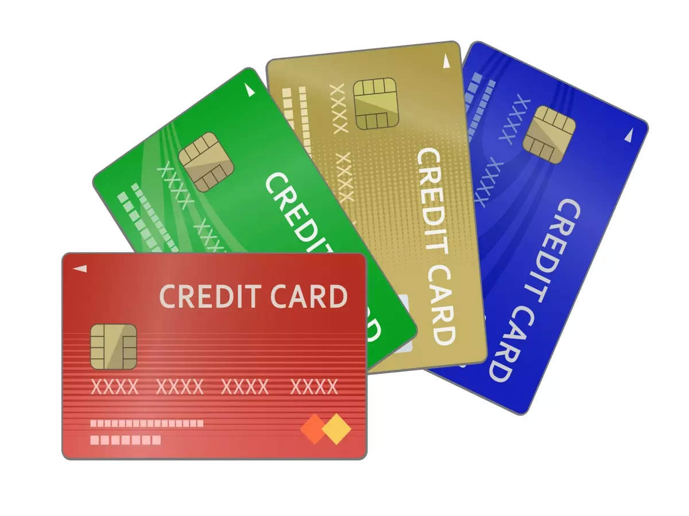

MITRON BANK New Credit Card Analysis by Peter Pandey Data Analyst Atliq Data Services
Anurag Dave
Data Analyst

Slide 2
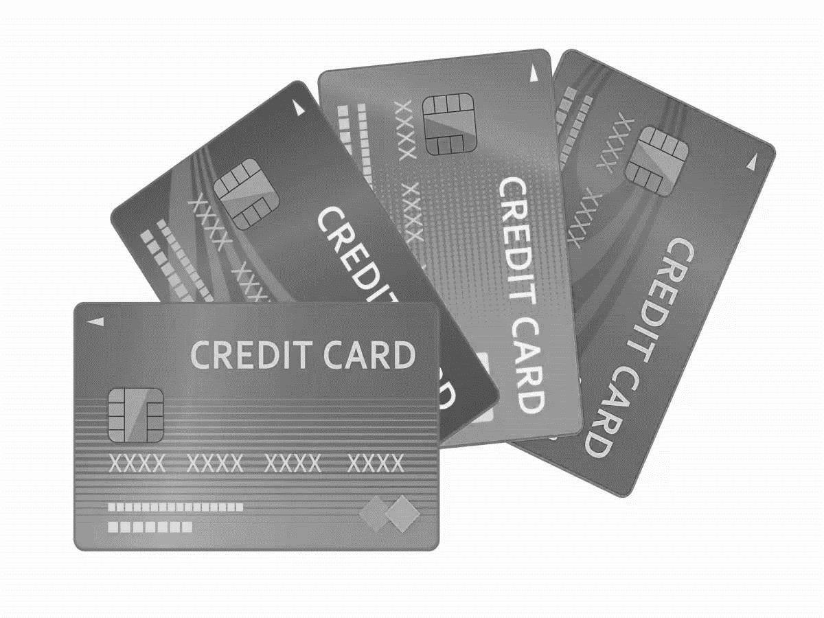

Problem Statement:
MITRON BANK
Mitron Bank, a legacy financial institution headquartered in Hyderabad,
want to introduce a new line of credit cards, aiming to broaden
its product offerings and reach in the financial market.

Slide 3

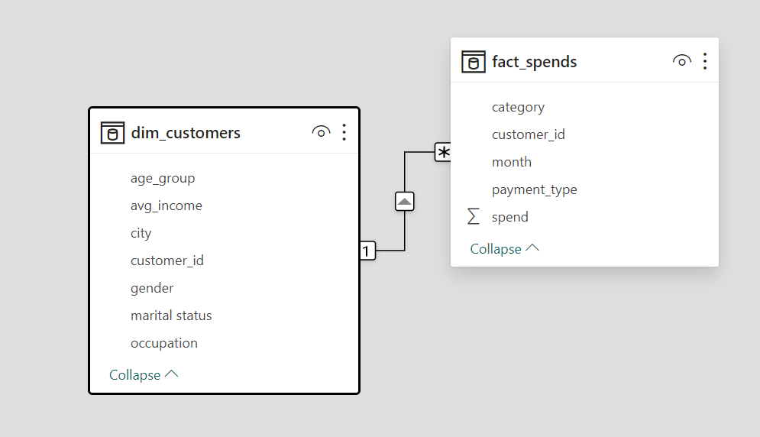
Data-set:

Slide 4
Key Insights
A Salaried IT Emp. has the highest avg spending & the highest avg income utilization.
Govt Employees have the highest % use of credit card.
Mumbai:
Salaried IT Employee -- All age Group
Freelance -- Age group 25-34, 35-45
Salaried other employee – Age Group 25-34, 35-45 & Single Male from 45+ age group
Delhi NCR:
Salaried IT Employee – All age groups except Married Female from 45+ age group
Freelance -- Age group 25-34, 35-45
Salaried other employee – Age Group 25-34, 35-45 & Male From 21-24 age group
Bengaluru:
Salaried IT Employee – Male from All age groups & Female from 25-34 & 35-45 group
Freelance – Male from age group 25-34, 35-45 & female from 35-45 group
Salaried other employee – Male from age Group 25-34, 35-45
Hyderabad:
Salaried IT Employee – Male from all age groups 25-34 & 35-45 group

Slide 5

Credit Card Feature Recommendations
Store Credit Card:
Tie up with offline Super Markets like: Big Bazaar ,Big Baskets etc.
Tie up with online platform like Chroma, Flipkart & Jio Mart etc.
Offer/discounts on the purchase of Groceries , Electronics
Key Customers:
Mumbai ,Delhi NCR & Bengaluru
Salaried IT, Freelancers & Salaried Other Employees from 25-45 age group

Slide 6
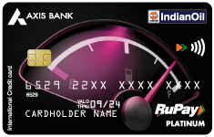
Credit Card Feature Recommendations
Rewards credit cards:
Credit card for Bill Category like Electricity ,Gas ,Petrol etc.
Tie up with oil company like Indian oil
Minimum annual fee
Cashback offer or Reward Points
Key Customers:
Male customers from Salaried IT, Freelancers
Age group from 25-45 & 45+
All cities

Slide 7
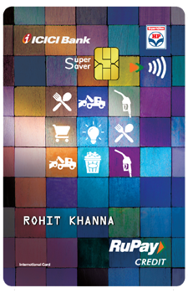
Credit Card Feature Recommendations
Young Professional Credit Card:
Special Card for Entertainments , Apparel & Dining(Food)
Contactless Payment
Minimum Subscription fees
Cashback reward
Key Customers:
Age Group 21-23 & Salaried IT Employees
Mumbai ,Delhi & Bengaluru

Slide 8

Credit Card Feature Recommendations
Health & Wellness Credit Card:
Online Fitness Application offers
Fitness products offer on selected platform
Quick &Instance Approval
Key Customers:
Age Group 35-45 & 45+
Female ,Salaried IT Employees
Mumbai ,Delhi & Bengaluru

Slide 9

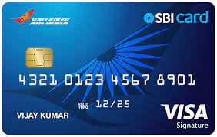
Credit Card Feature Recommendations
Travel credit cards:
Tie up with Domestic airlines
Airport lounge Access
Hotel Discounts
Travel Insurance
Key Customers:
Age Group 25-34,35-45 & 45+
Salaried IT Employees , Married Person
Mumbai ,Delhi & Bengaluru

Slide 10
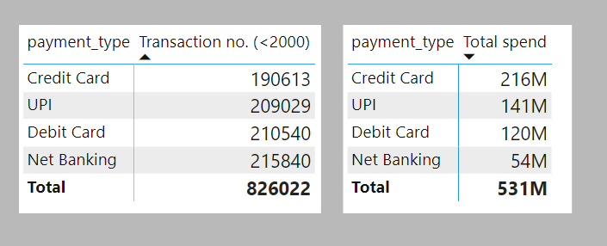
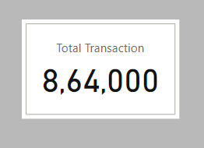
Credit Card Feature Recommendations
Mitron RuPay Credit Card for UPI:
Launch of RuPay Credit Card & Link it with UPI
No transaction charges on the sum value less than 2000/-
No need to carry physical card everywhere
Cashback Reward
Can be paid to any merchant

Slide 11


